Slide 1
Capstone Engagement Assessment, Analysis, and Hardening of a Vulnerable System
Prepared by Nicole Plybon
Notes:
Thank you for attending the Capstone Engagement Assessment, Analysis, and Hardening of a Vulnerable System Presentation!

Slide 2
Table of Contents
This document contains the following sections:
Management Summary
01
Network Topology
02
03
Red Team: Security Assessment
04
Blue Team: Log Analysis and Attack Characterization
Hardening: Proposed Alarms and Mitigation Strategies
05
Notes:
During our time together we will review the following sections
01 - We will do a high level overview of the Management Summary
02 – Talk through the network topology and how the network is configured
03 – Identify how the Red Team exploited the system and go through the security assessment
04 – Review how the Blue team reviewed and analyze the logs to identify the attack characterization
05 – Then finally review different alarms/alerts and mitigation strategies to implement to harden the system and assist in preventing this in the future

Slide 3
Management Summary
3

Slide 4
Management Summary
This report outlines the Assessment, Analysis and Hardening of a Vulnerable System within the company
The Capstone Web Server system was the target
The Capstone Web Server was successfully exploited on Saturday November 7th, 2020
Sensitive data was obtained and lead to further Exploitation, which resulted in the remote backdoor access to the system
Several vulnerabilities were present, and the opportunity for detection was missed, which is detailed within the report for review
Mitigation strategies were provided along with key examples to assist in hardening the system and prevent future exposure risk

Slide 5
Network Topology
5

Slide 6
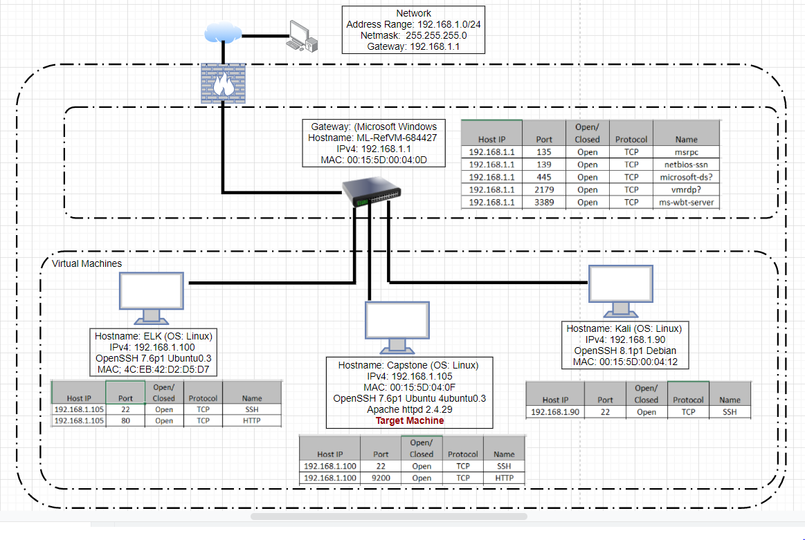
Network Topology
Network
Address Range: 192.168.1.0/24
Netmask: 255.255.255.0
Gateway: 192.168.1.1
Machines
Ipv4: 192.168.1.1
OS: Windows
Hostname: Gateway / ML-RefVM-684427
Ipv4: 192.168.1.90
OS: Linux
Hostname: Kali
Attacker Machine
Ipv4: 192.168.1.100
OS: Linux
Hostname: ELK
Ipv4: 192.168.1.105
OS: Linux
Hostname: Capstone
Target Machine

Slide 7

Red Team Security Assessment
7

Slide 8
Recon: Describing the Target
Nmap identified the following hosts on the network:
Hostname | IP Address | Role on Network
ML-RefVM-684427 | 192.168.1.1 | Gateway/Jump Box
Kali | 192.168.1.90 | Attacker’s Machine
ELK | 192.168.1.100 | Network Security Monitor (NSM) / Log Analysis
Capstone | 192.168.1.105 | Webserver / Target Machine

Slide 9
Vulnerability Assessment
The assessment uncovered the following critical vulnerabilities in the target:
Vulnerability | Description | Impact
Sensitive Data Exposure | Sensitive data was accessible from the internet. Red Team was able to use the browser to read the full contents of directories on the Capstone server. | The contents of the directories revealed that Ashton is the administrator for the director: /company_folders/secret_folder
Security Misconfiguration / Weak Password Policy | System settings allow brute force attack of password. Passwords were easily cracked using Hydra and crackstation.net. No lockout for failed login attempts allowing for a potential brute force attack. | Allowed the Red Team to brute force attack Ashton’s password. This allowed the Red Team to gain access to the secret folder containing additional information
Unrestricted File Upload | Uploaded .php files represents a significant risk to applications/systems. | Allowed the Red Team to gain root access to the Capstone web server and create a backdoor to the network
Notes:
3 critical vulnerabilities were identified
1. Sensitive Data Exposure
2. Security Misconfiguration / Weak Password Policy
3. Unrestricted File Upload
Here you can see the vulnerability, the description of the vulnerability and then the resulting impact
Sensitive Data was accessible which resulted in the Red Team gaining access and using the web browser to view the company confidential information.
The critical information that was viewed identified that Ashton is the administrator for a secret folder
Security Misconfiguration / Weak password policy resulted in a brute force attack on Ashton’s password. The Red team used Hydra and crackstation.net to successfully gain the password information and accessed the secret folder
There are no password policies in place to prevent multiple failed login attempts which allowed this brute force attack
Unrestricted file upload represents a significant risk to applications and systems. The Red Team was able to uploaded a .php file which allowed to gain root access to the Capstone web server and create a backdoor into the network

Slide 10
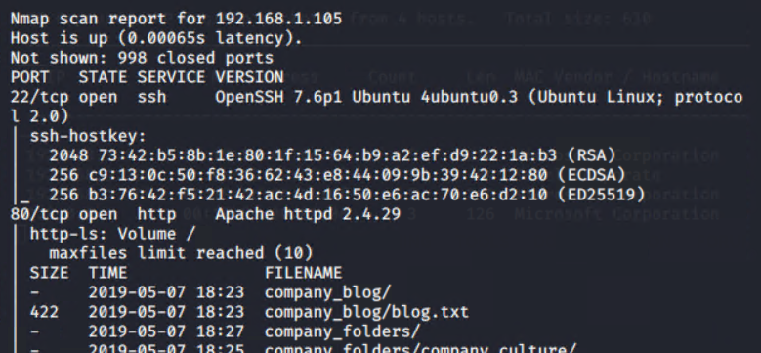
Exploitation: Sensitive Data Exposure
Tools & Processes
Nmap was used to run a scan on IP range 192.168.1.0/24.
The scan reveled that ports 22 and 80 were open. This allowed the Red Team to navigate to 192.168.1.105 with a web browser to gain access and naviagted to the different folders and discovered that the secret_folder existed
Nmap –sS –A 192.168.1.1/24
01

Slide 11
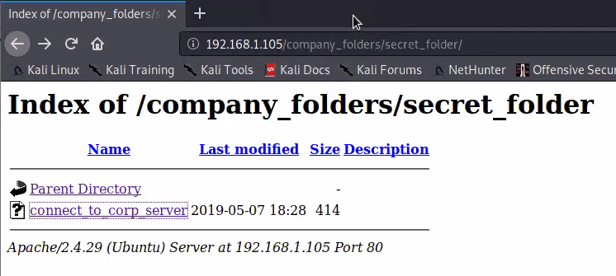
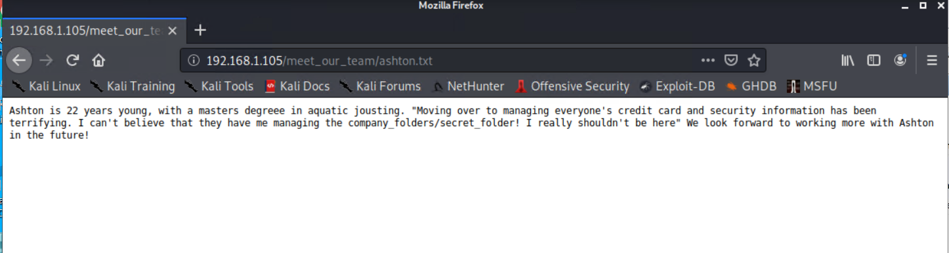
Exploitation: Sensitive Data Exposure
Achievements
The information obtained with the nmap scan and reviewing the contents of the company directories provided further information that Ashton is the admin for the /company_folder/secret_folder/. The seccret folder contains sensitive information which is used to execute the brute force attack and steal data.
02
Results
03
Notes:
Contents of the Secret Folder

Slide 12
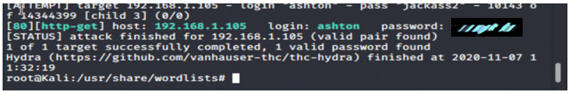
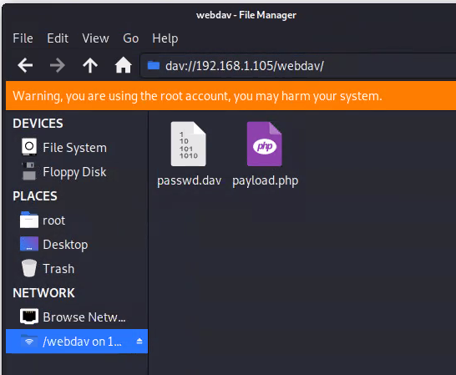
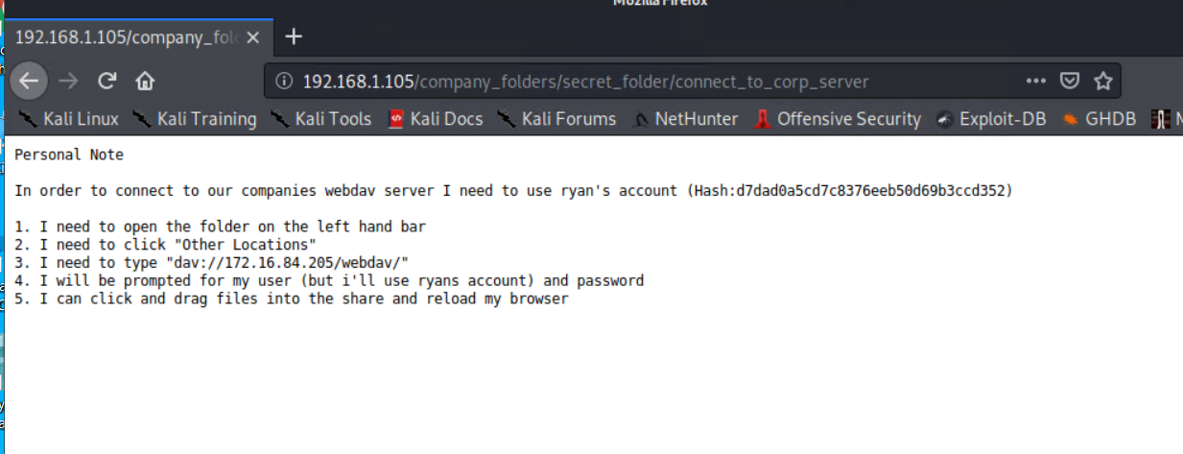
Exploitation: Security Misconfiguration / Weak Password Policy
Tools & Processes
Executed Hydra to conduct the brute force dictionary attack using the rockyou.txt file to get Ashton’s password
01
Achievements
Hydra was used to brute force Ashton’s password which allow us to gain access to the company’s /secret_folder/. Has for Ryan’s password was found and cracked allowing access to dav://192.168.1.105/webdav/
02
Results
03

Slide 13
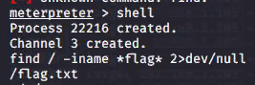

Exploitation: Unrestricted File Upload
Tools & Processes
Created and uploaded msfvenom payload: php/meterpreter/reverse_tcp
Established the remote listener
Executed reverse shell backdoor on the Capstone web server
01
Achievements
Webdav was not secure and allowed the Red Team to upload the .php file which created a reverse shell backdoor onto the Capstone 192.168.1.105 web server.
02
Results
Reverse shell backdoor established
03

Slide 14

Blue Team Log Analysis and Attack Characterization
14

Slide 15
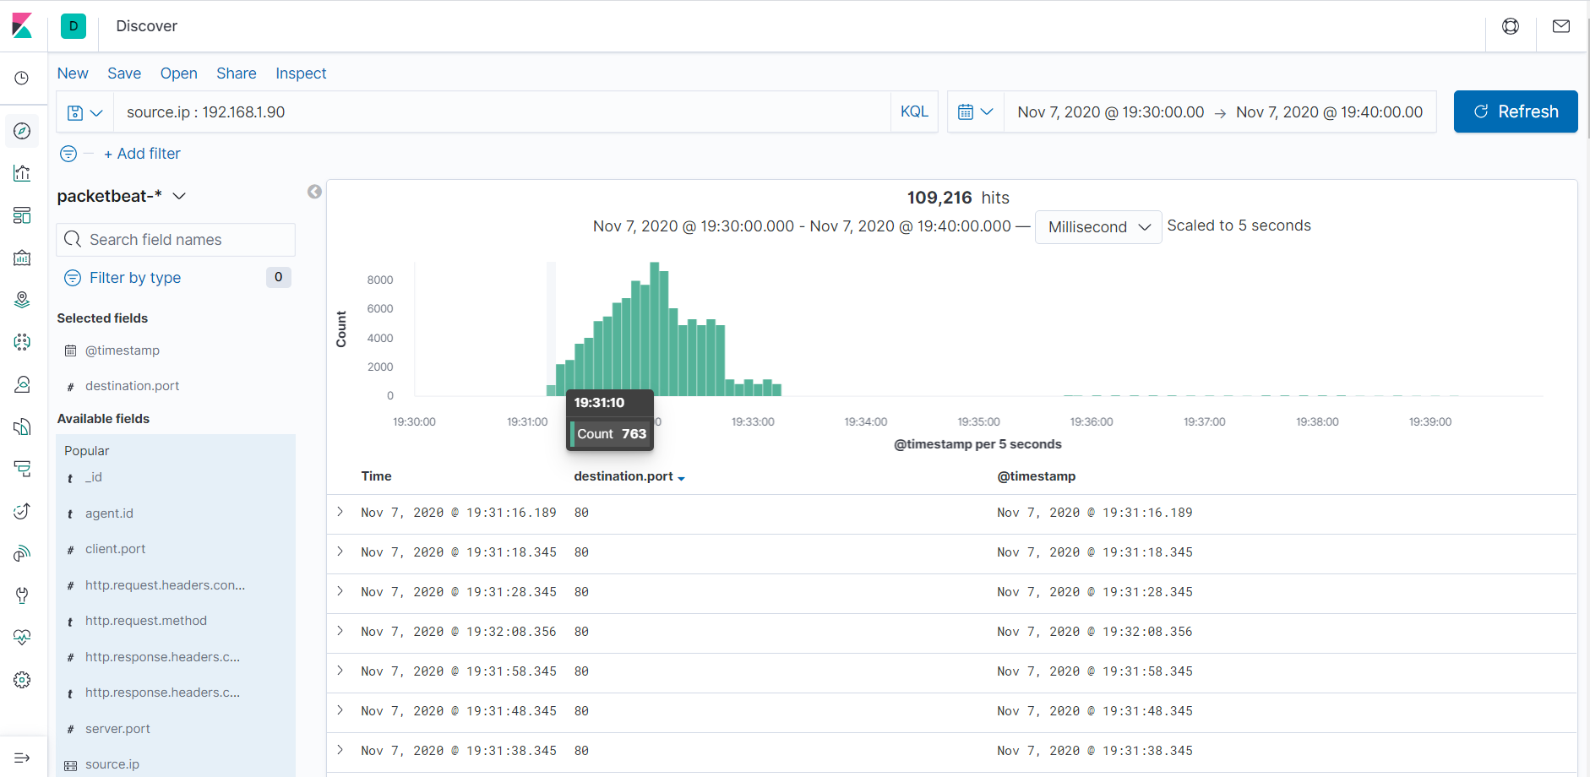
Analysis: Identifying the Port Scan
Port scan occurred on Nov 7th, 2020 @ 19:31:10 with 763 packet sent from 192.168.1.90
109, 216 packets were sent from 192.168.1.90
Multiple ports requested at the same time are indicative of a port scan

Slide 16
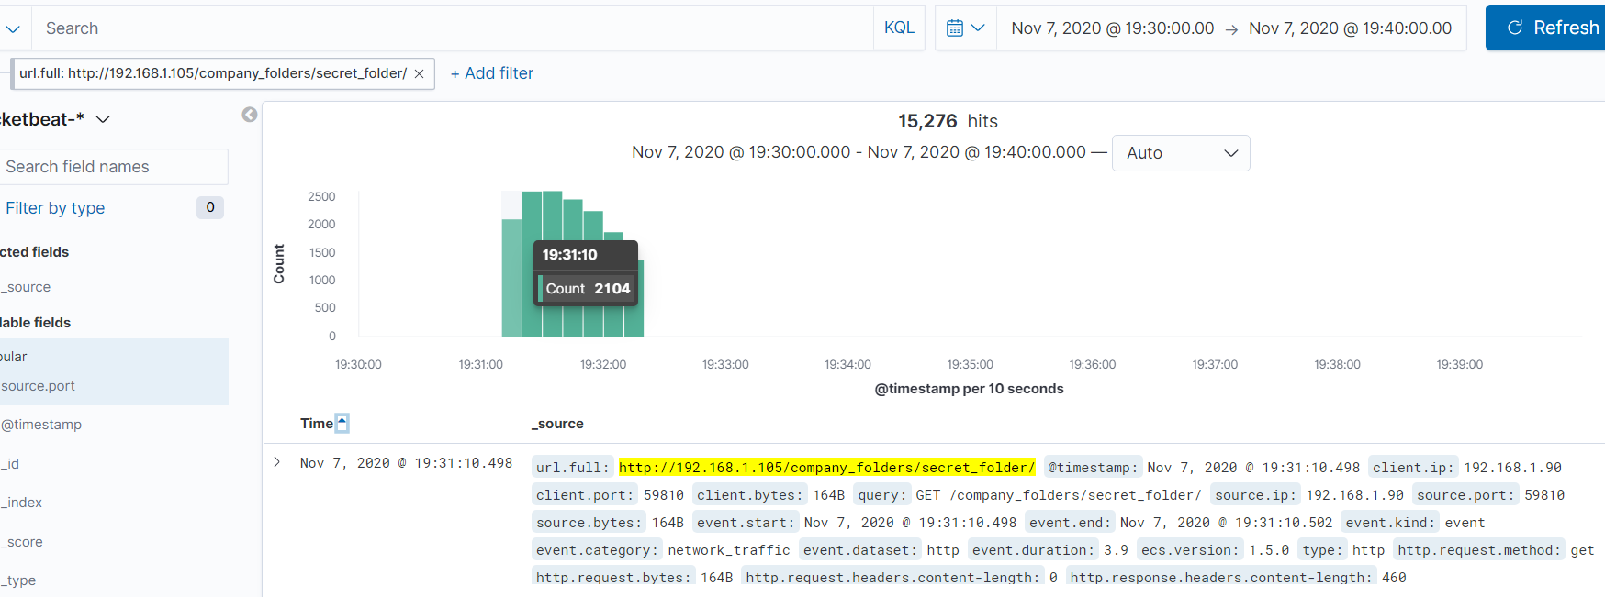

Analysis: Finding the Request for the Hidden Directory
The first request occurred on Nov 7th starting at 19:31:10 (7:31:10 pm)
15,280 requests were made to the /secret_folder, mostly durning the brute force attack
The “http://192.168.1.105/company_folders/secret_folder/ file was attacked with 15,280 requests. This file contains instruction for connecting to webdav and Ryan’s hashed password which was cracked using crackstation.net

Slide 17
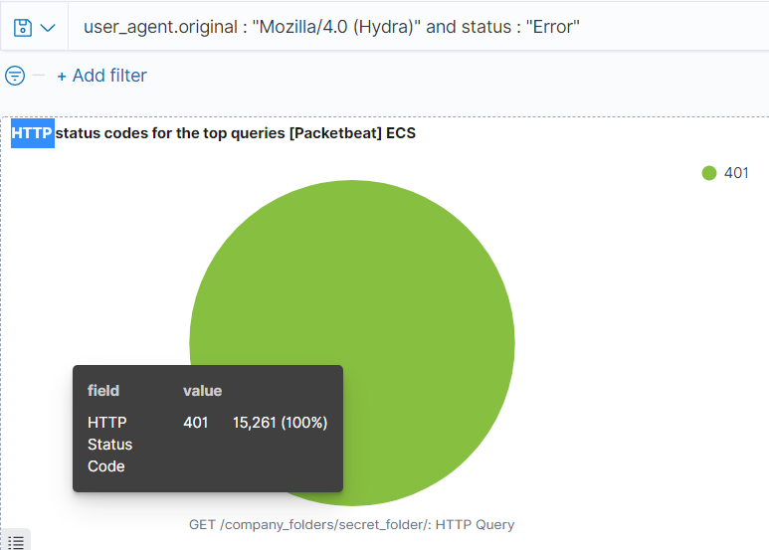
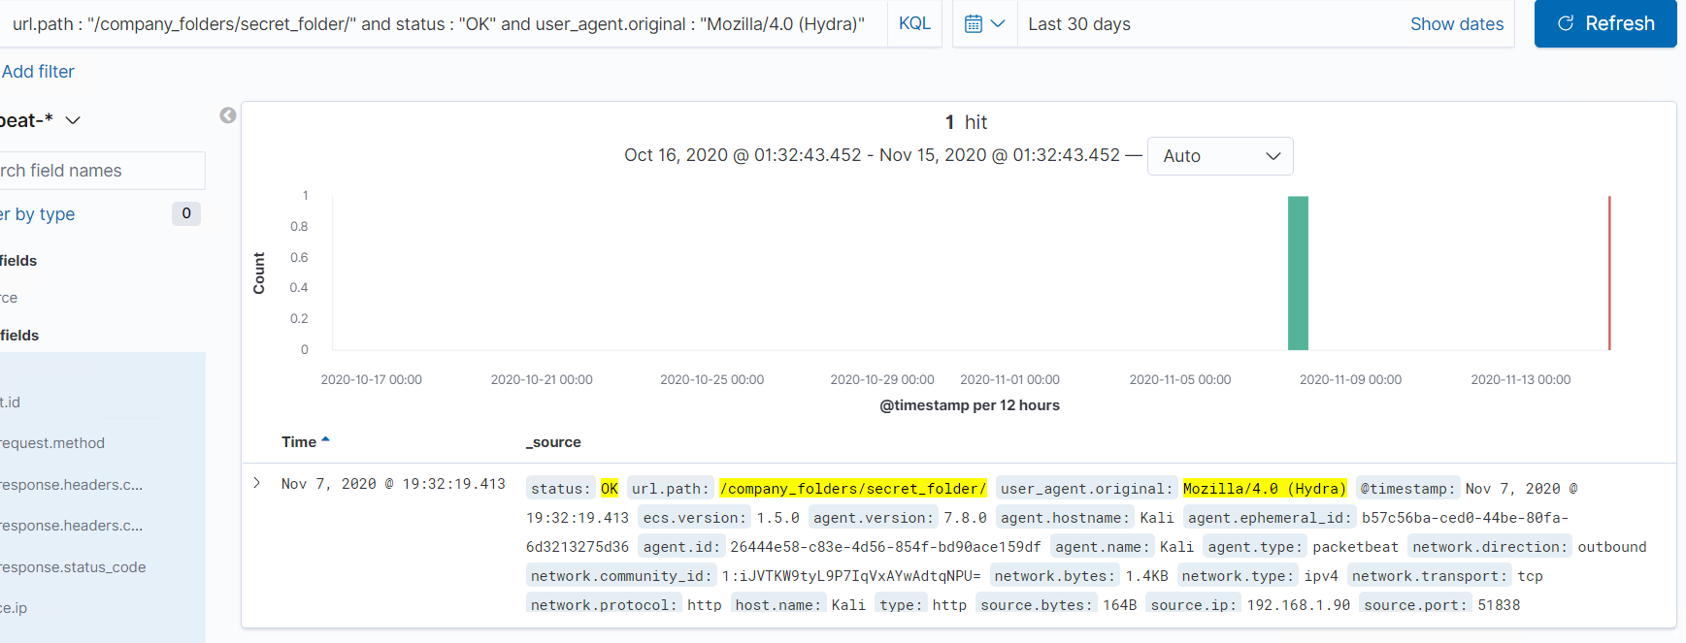
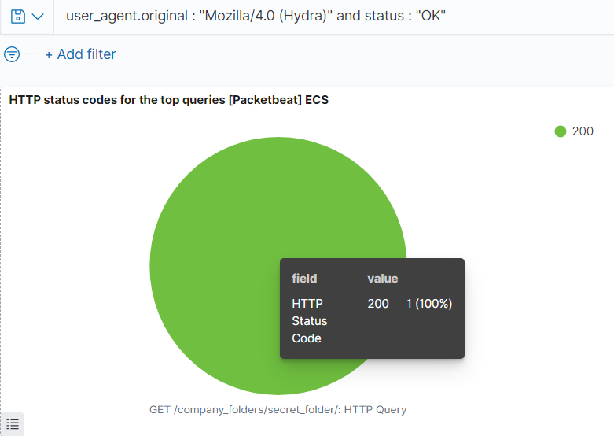
Analysis: Uncovering the Brute Force Attack
15,261 requests were made in the direct brute force attack before the password was cracked
The password was discovered on Nov 7th , 2020 at 19:32:19 (7:32:19 pm) and the attacker was able to gain access to the system and the /secret_folder/

Slide 18
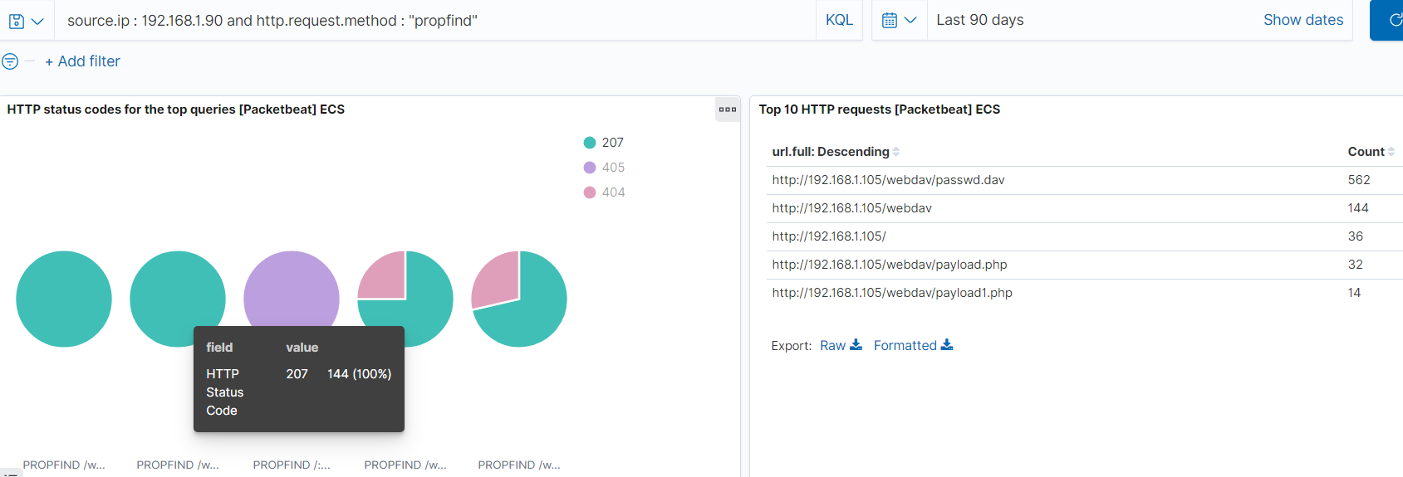
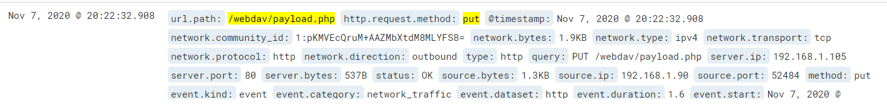
Analysis: Finding the WebDAV Connection
The http://192.168.1.90/webdav/ directory was requested 144 times
The http://192.168.1.90/webdav/passwd.dav was requested 562 times
The http://192.168.1.90/webdav/payload.php was requested 32 times
Backdoor payload.php was uploaded on Nov 7 at 20:22:32
Notes:
PUT method is used to create or overwrite a resource at a particular URL that is known by the client.

Slide 19
Blue Team Proposed Alarms and Mitigation Strategies
19

Slide 20
Mitigation: Blocking the Port Scan
The following alarms can be set to detect future port scans.
Alarm that detects any IP address that is scanning the network that is not a trusted IP address (Trusted IP address should be placed on the Whitelist)
Alarm that detects destination ports that are not 80 and 443 and attempted access > 100 requests per second intervals
Alarm details/threshold:
Alert emails and log > 100 requests per second intervals against destination ports that are not 80 and 443 and detected in the same time stamp from the same IP
What configurations can be set on the host to mitigate port scans?
Conduct internal port scans to determine if there are more ports open than required. Check system to determine existing weak points that could be exploited.
Firewall equipped with well-audited rules, close off all unused ports (protecting ports that are exposed and their visibility), make sure that all remote users and access points are secured.
Configure a Web Application Firewall to detect and block malicious requests before they reach users applications

Slide 21
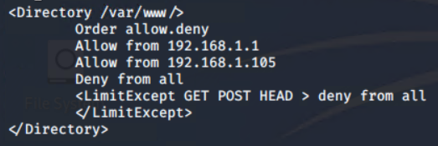
Mitigation: Finding the Request for the Hidden Directory
What confirmation can be set on the host to block unwanted access?
All sensitive data should be removed and never placed on public facing web servers
Managing IP’s by Whitelisting and Blacklisting rules
Httpd.conf file configuration:
Nano /etc/httpd/conf/httpd.conf (file location may vary)
Locate directory section (/var/www/) and set as follows:
Blacklisted IP’s will not be able to access the ‘secret_folder/
The following alarm can be set to detect future access to directories with sensitive data
Sensitive files or directories accessed by non whitelisted IP addreses
Whitelist only the trusted IP addresses and firewall rules to deny any non-trusted IP’s
Alert details/threshold:
Alert email and log when protected files and directories containing sensitive data are accessed by outside non-trusted IP addresses.
Alert email and log when > 1 attempt is made to access the /secret_folder/ from IP’s other than on the Whitelist

Slide 22
Mitigation: Preventing Brute Force Attacks
The following alarm can be set to detect future brute force attacks
Any Error (401) responses detecting in > 100 requests per second intervals requests
Any OK (200) responses from a non-trusted IP address
Whitelist only the trusted IP addresses and firewall rules to deny any non-trusted IP’s
Alert details/threshold:
Alert email and log > 5 failed login attempts within a 1 time timestamp
Alert email for any login attempts by Mozilla/4.0 (Hydra)
Alert email for any login attempts from an untrusted outside IP address attempting to log into the system
Enforce a strong password policy
Limit failed login attempts
Use Captcha to ensure the user is human
Limit logins to a specified IP address or range
Two factor authentication
Unique login URLs
Monitoring logs

Slide 23
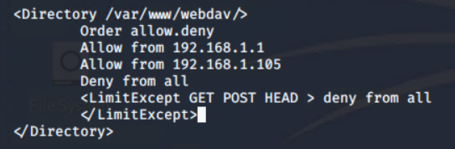
Mitigation: Detecting the WebDAV Connection
The following alarm can be set to detect future access to directories with sensitive data
Monitor sensitive files or directories accessed on webdav by non whitelisted IP addreses. Monitor with Filebeat
Whitelist only the trusted IP addresses and firewall rules to deny any non-trusted IP’s
Alert details/threshold:
Alert email and log when protected files are accessed on the webdav directories containing sensitive data by outside non-trusted IP addresses.
Alert email and log when > 1 attempt is made to access the webdav directory from IP’s other than on the Whitelist
What confirmation can be set on the host to block unwanted access?
All sensitive data should be removed and never placed on public facing web servers
System Administors should install and configure Filebeat to monitor activity on the network
httpd.conf file configuration:
Nano /etc/httpd/conf/httpd.conf (file location may vary)
Locate directory section (/var/www/) and set as follows:

Slide 24
Mitigation: Identifying Reverse Shell Uploads
The following alarm can be set to detect future uploads?
Alarm when a “put” HTTP request from a non whitelisted IP indicating server files are altered
Alarm when there is a POST request that contains a file being uploaded that is not in a premitted format such as .php
Alert details/threshold:
Alert email and log when “put” request method is made on protected files or directories containing sensitive data are being accessed by outside non-trusted IP addresses.
Alert email and log when a forbidden file is being uploaded by a non-trusted IP address
What configuration can be set on the host to block file uploads?
Filebeat should be enabled and configured to montior for format file types that are not permitted (i.e. .php)
Whitelisting and Blacklisting in the httpd.conf file configuration:
Nano /etc/httpd/conf/httpd.conf (file location may vary)
Locate directory section (/var/www/) and set as follows:

Slide 25
Questions?
25

Slide 26
Thank You!

